Slide 1
Kruskal’s Algorithm

Slide 2
Kruskal’s Algorithm-
Kruskal’s Algorithm is a famous greedy algorithm.
It is used for finding the Minimum Spanning Tree (MST) of a given graph.
To apply Kruskal’s algorithm, the given graph must be weighted, connected and undirected.

Slide 3
Kruskal’s Algorithm Implementation-
The implementation of Kruskal’s Algorithm is explained in the following steps-
Step-01:
Sort all the edges from low weight to high weight.

Slide 4
Step-02:
Take the edge with the lowest weight and use it to connect the vertices of graph.
If adding an edge creates a cycle, then reject that edge and go for the next least weight edge.

Slide 5
Step-03:
Keep adding edges until all the vertices are connected and a Minimum Spanning Tree (MST) is obtained.

Slide 6
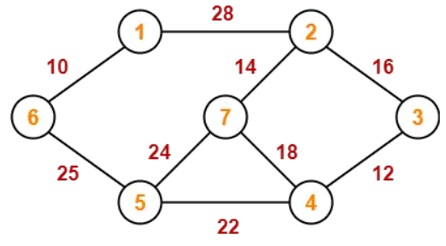
PRACTICE PROBLEMS BASED ON KRUSKAL’S ALGORITHM-
Construct the minimum spanning tree (MST) for the given graph using Kruskal’s Algorithm-

Slide 7
To construct MST using Kruskal’s Algorithm,
Simply draw all the vertices on the paper.
Connect these vertices using edges with minimum weights such that no cycle gets formed.

Slide 8
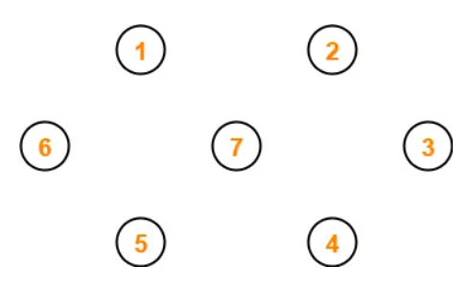
Step-01:

Slide 9
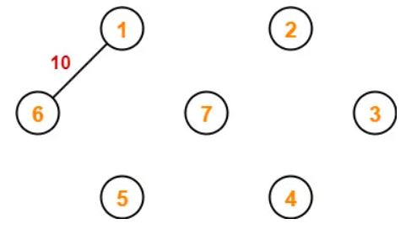
Step-02:

Slide 10
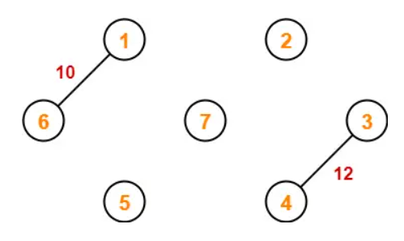
Step-03:

Slide 11
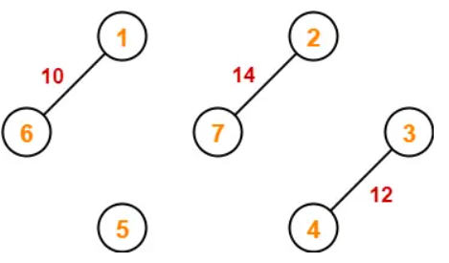
Step-04:

Slide 12
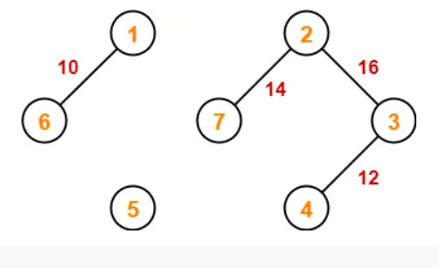
Step-05:

Slide 13
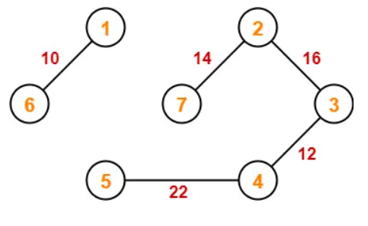
Step-06:

Slide 14
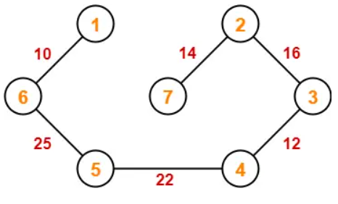
Step-07:

Slide 15
Since all the vertices have been connected / included in the MST, so we stop.
Weight of the MST
= Sum of all edge weights
= 10 + 25 + 22 + 12 + 16 + 14
= 99 units

